Slide 1

Organ Donation

Slide 2
Organ Donation Management System
TEAM MEMBERS
Trisha Chander
V Ganith
Vasanth S

Slide 3
Abstract
Hospitals are of great value to human society and there are several patients waiting for organs in order to be saved. Due to the growing information age we live in , it has become necessary to have an efficient computerised system to manage data about number of donors and patients who require a donation.
A national level database is required in order to manage the records of patients , hospitals ,and donors so that lives can be saved.
The software requirements involve an efficient application to manage the records which involve patients waiting list (contains hospital id foreign key connecting to hospital table): List of patients that need a donation and their contact details
organ donor list :(people alive who have pledged that the they will donate and their respective details like Name, Date Of Birth )
Organisations (Opo) table: organisations list along with unique id who can access database and their organs enlistment and their
work will be recorded
Cold storage bank( both private and NGOs) : tells about each bank, different organs available, ...
Hospitals : contains data of hospitals with their track of no of successful donation operations
The application must help in accessing the records for analysts as well as for opos for organ accessing and donors to pledge to donate
IT must contain a good frontend and a convenient database backend which ensures data integrity and security.

Slide 4




Softwares
Front End:
HTML
CSS
Javascript
Back End:
MySQL
PHPmyadmin (php)

Slide 5

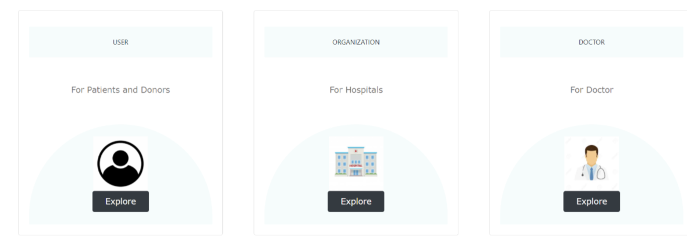
Modules
Home
About
Log In
Sign Up
Explore UIs for users

Slide 6
Entities
User
Patient
Donor
Login
Doctor
Organization

Slide 7
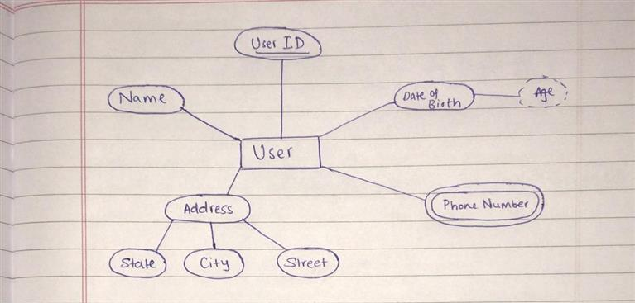
Attributes

Slide 8
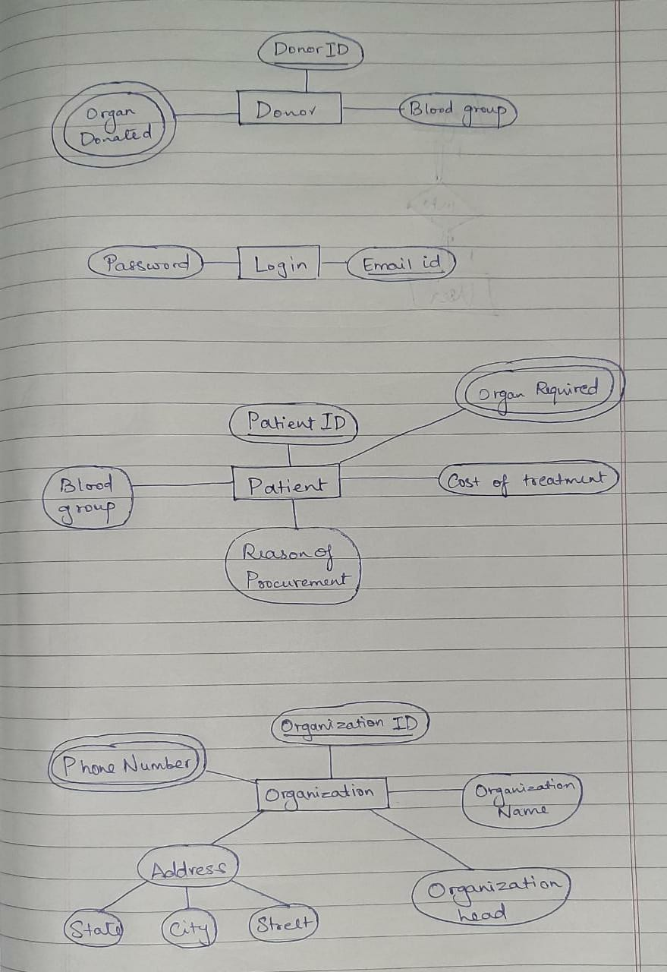
Attributes

Slide 9
Attributes

Slide 10
Attributes

Slide 11
Attributes

Slide 12
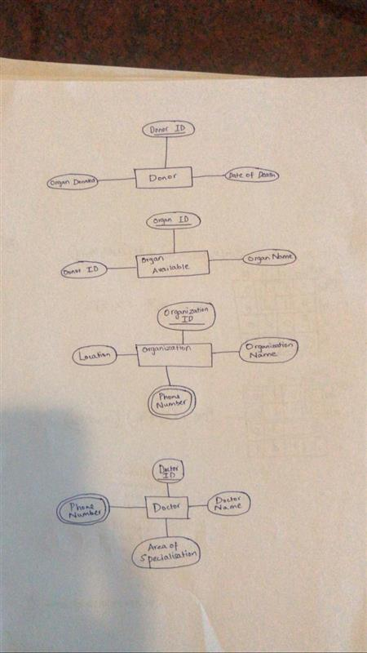
Attributes

Slide 13
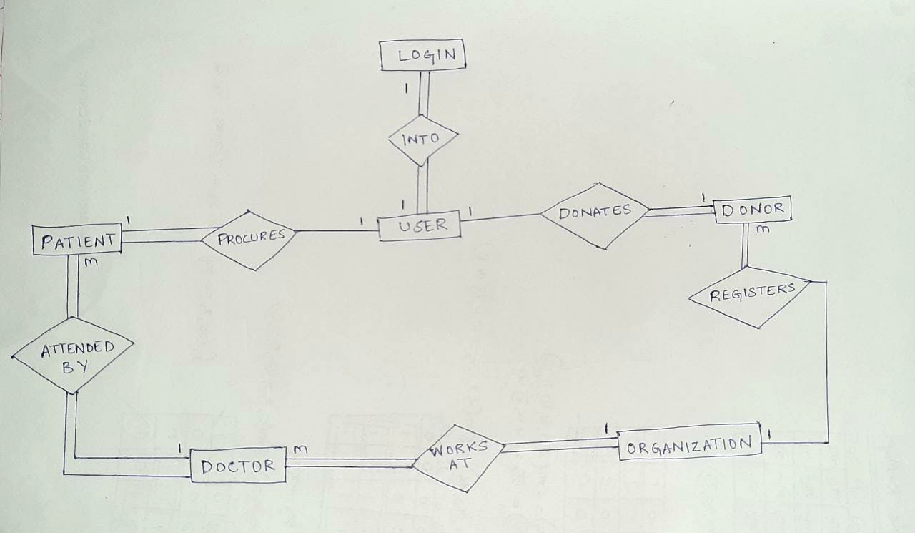
ER Diagram

Slide 14
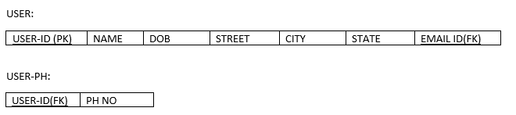
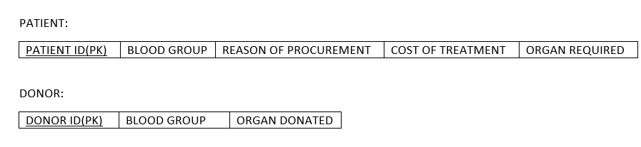
TABLES BEFORE CONVERSION

Slide 15
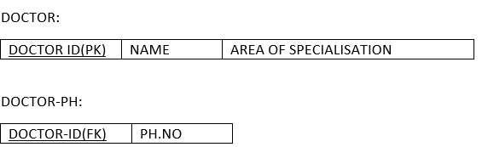
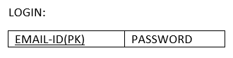
TABLES BEFORE CONVERSION

Slide 16
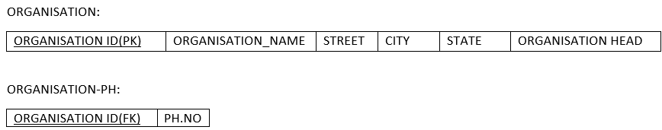
TABLES BEFORE CONVERSION

Slide 17
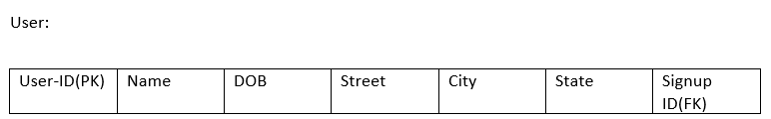
TABLES AFTER CONVERSION

Slide 18
TABLES AFTER CONVERSION

Slide 19
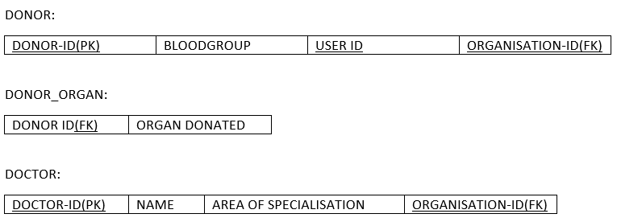
TABLES AFTER CONVERSION

Slide 20
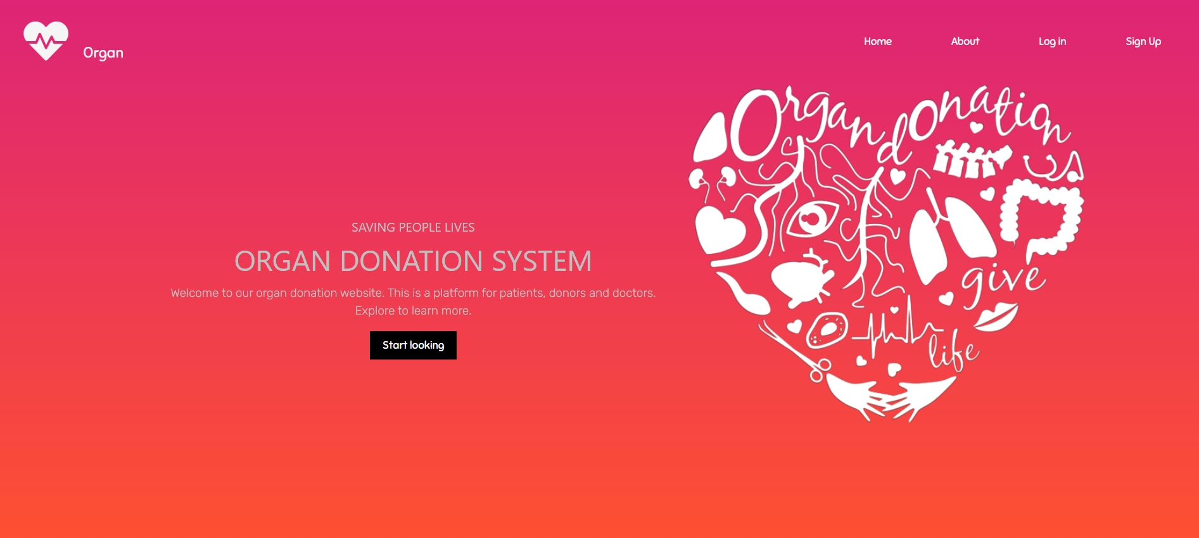
Home Page

Slide 21
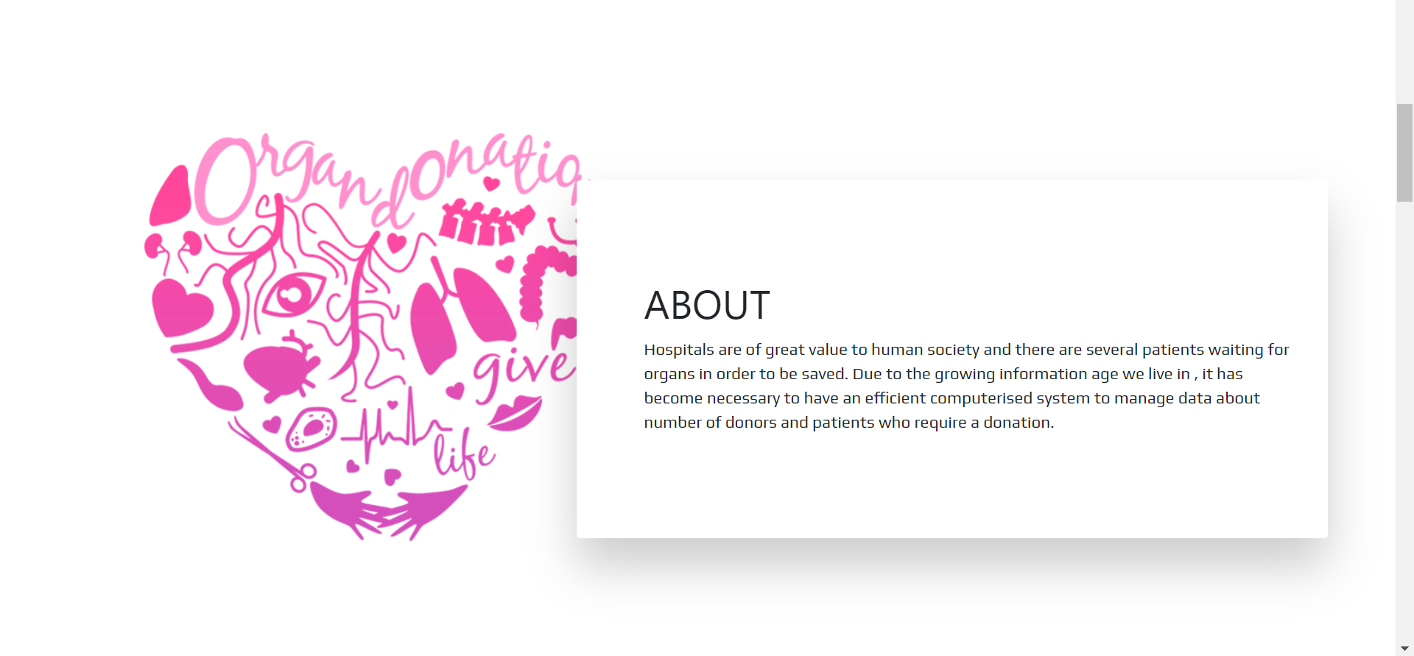
About

Slide 22
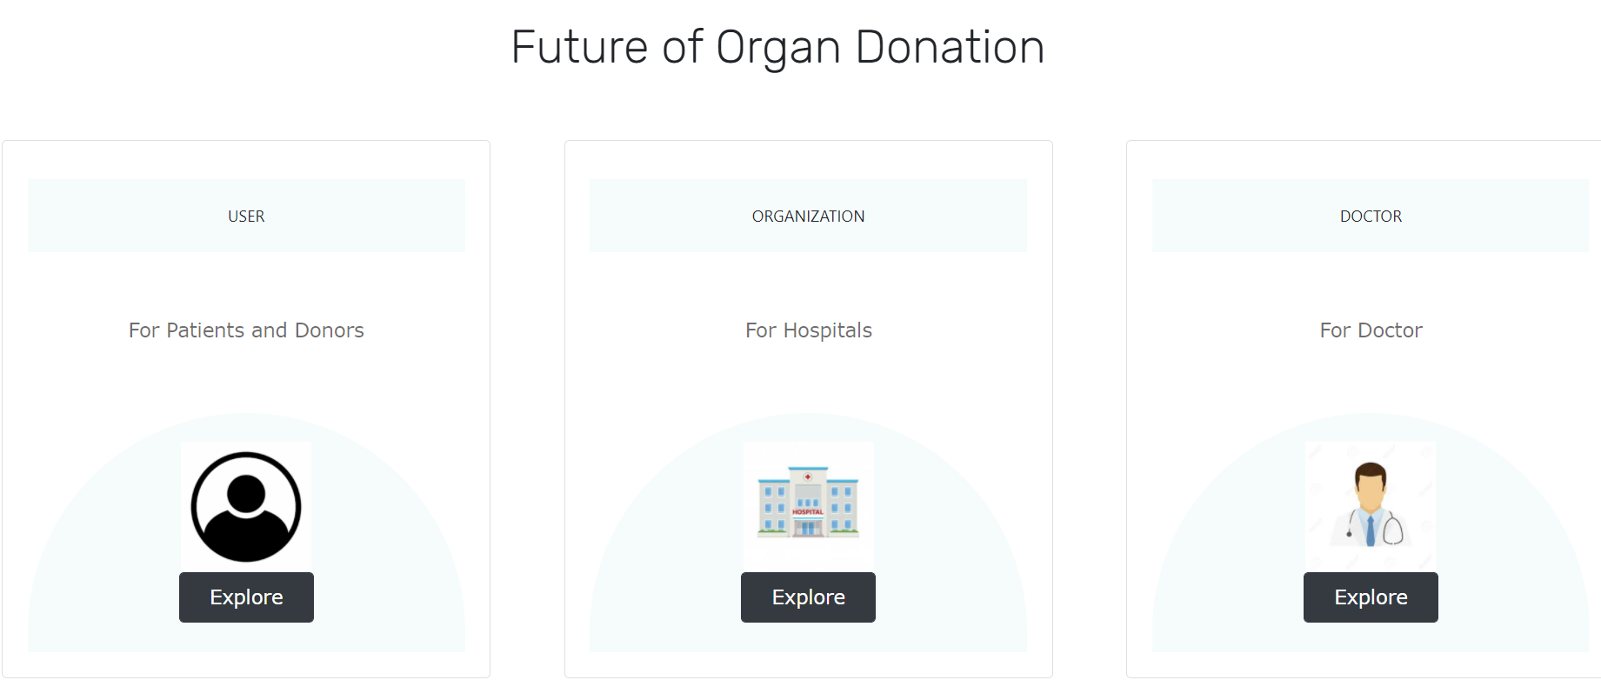
Explore

Slide 23
Queries

Slide 24
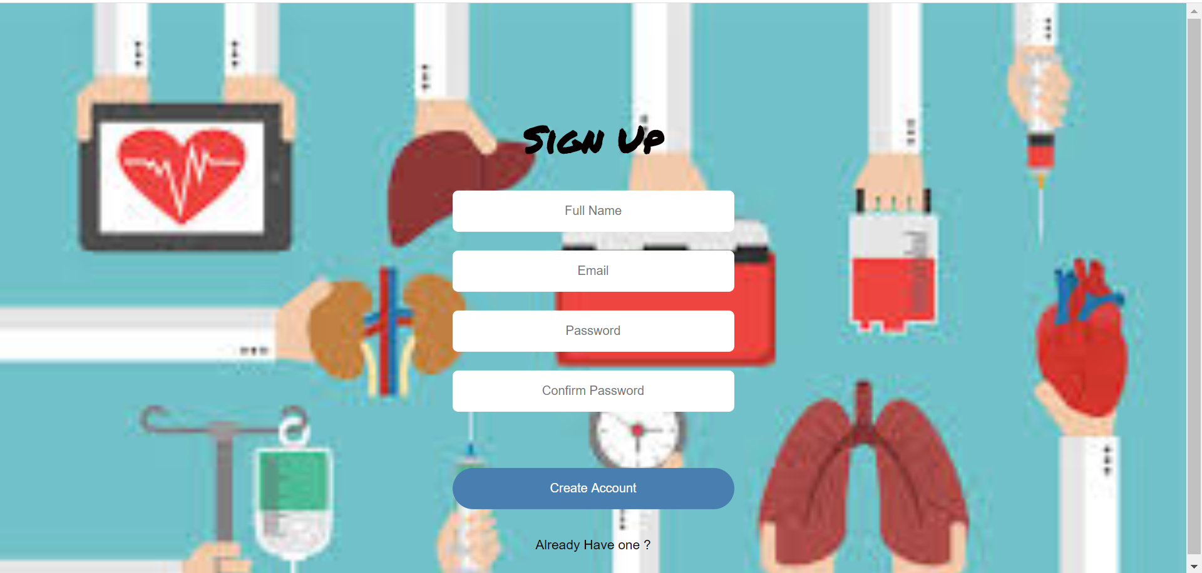
Sign up
INSERT INTO signup (name1,email,pass) VALUES (:name1,:email,:pass)

Slide 25

log in
$stmt=$pdo->prepare("SELECT signup_id,name1,email,pass from signup where email=:xyz and pass=:zyx ");

Slide 26
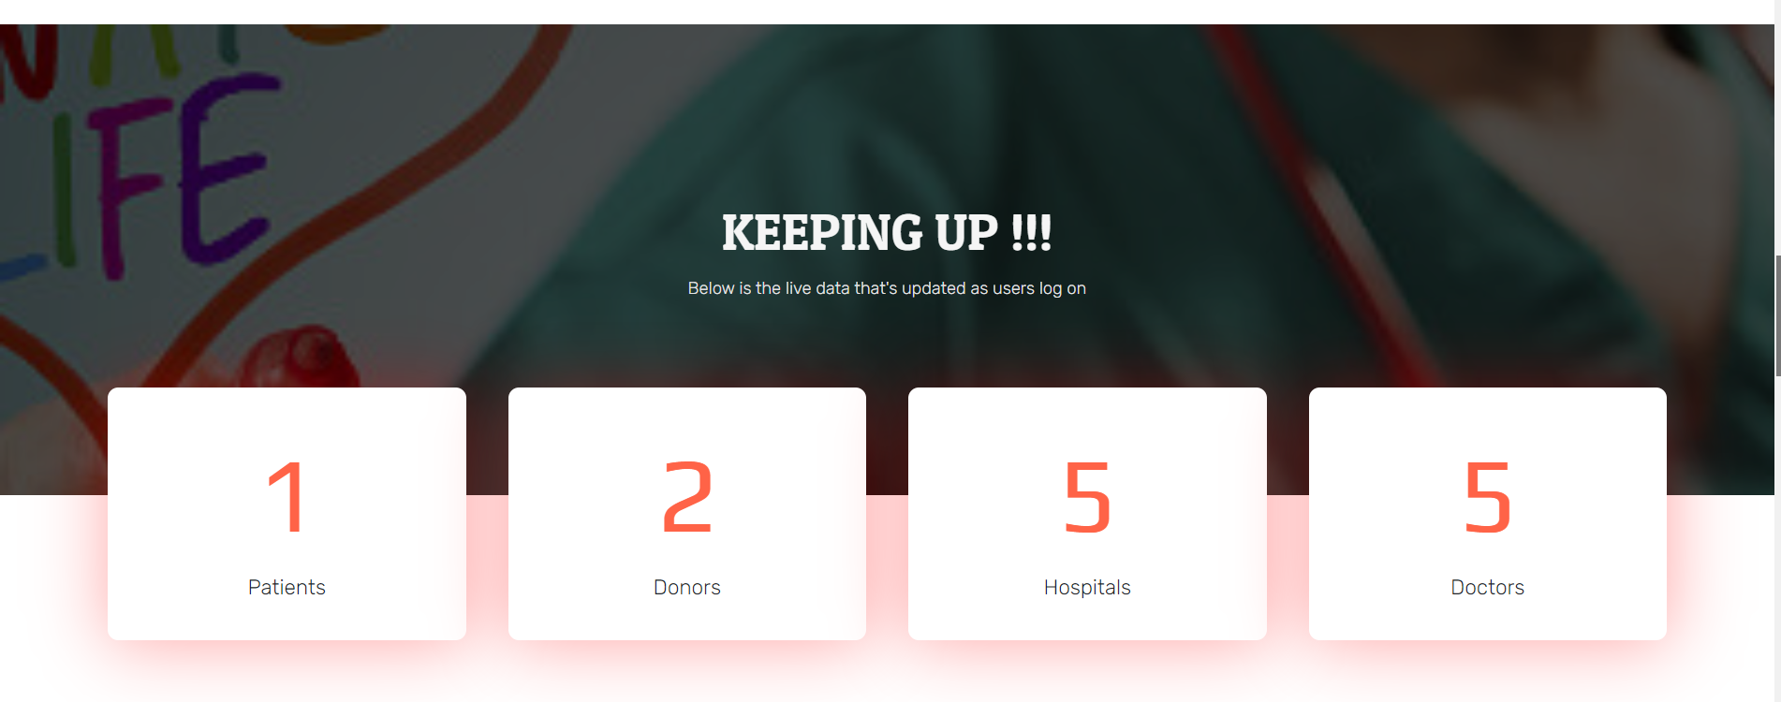
live count
$stmt1=$pdo->query("SELECT count(*) as count from patient ");
$stmt1=$pdo->query("SELECT count(*) as count from donor ");
$stmt1=$pdo->query("SELECTcount(*) ascountfrom organisation ");
$stmt1=$pdo->query("SELECTcount(*) ascountfrom doctor ");

Slide 27
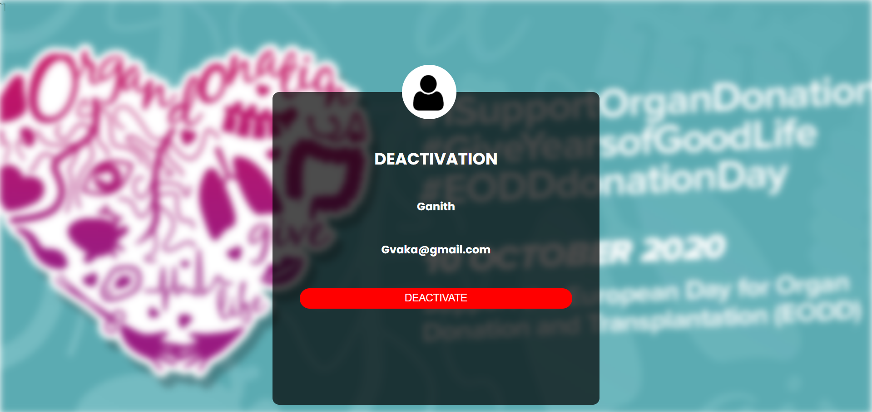
DEACTIVATION
$stmt=$pdo->prepare("DELETE patient FROM user2 INNER JOIN patient ON user2.user_id = patient.user_id WHERE signup_id=:tyu");

Slide 28
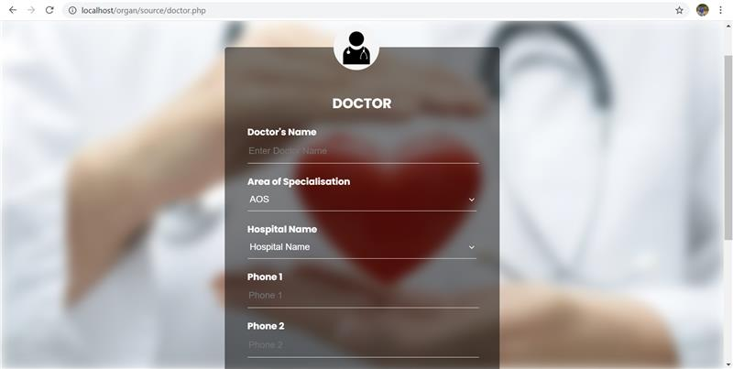
DOCTOR FORM
$sql="INSERT INTO doctor (name,area_of_specialisation,organisation_id) VALUES (:name2,:area,:id)";
$sql4="INSERT INTO doctor_ph (doctor_id,phone_no) VALUES (:doc,:phone1)";

Slide 29
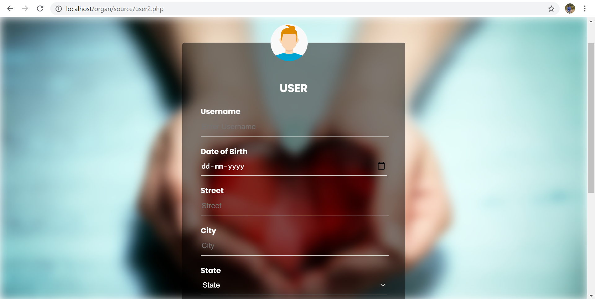
USER FORM
$sql="INSERT INTO user2 (name1,dob,street,city,state1,signup_id) VALUES (:name1,:dob,:street,:city,:state1,:signup)";
$sql1="INSERT INTO user_ph (user_id,phone_no) VALUES (:user,:phone1)";

Slide 30
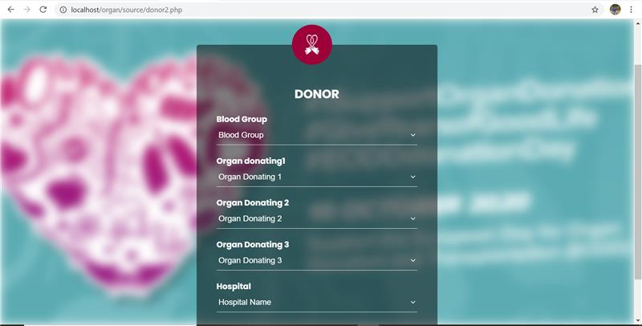
DONOR FORM
$sql="INSERT INTO donor (blood_group,user_id,organisation_id) VALUES (:blood,:userid,:orgid)";
$stmt=$pdo->query("SELECT MAX(donor_id) as max from donor");

Slide 31
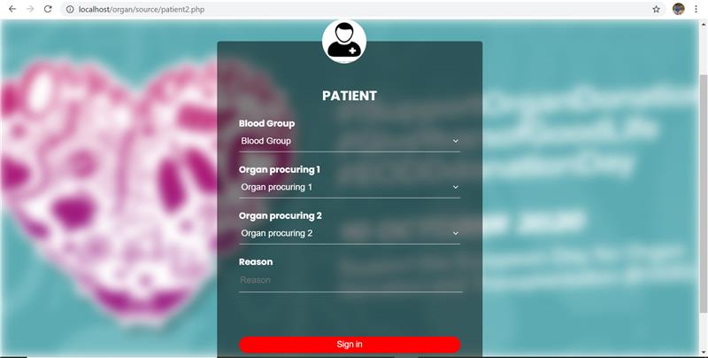
patient FORM
$sql="INSERT INTO patient (blood_group,reason,cost,user_id) VALUES (:blood,:reason,:cost,:userid)";
$sql="INSERT INTO patient_organ (patient_id,Kidney,Lungs,Eyes) VALUES (:did,:kid,:lung,:eye)";

Slide 32
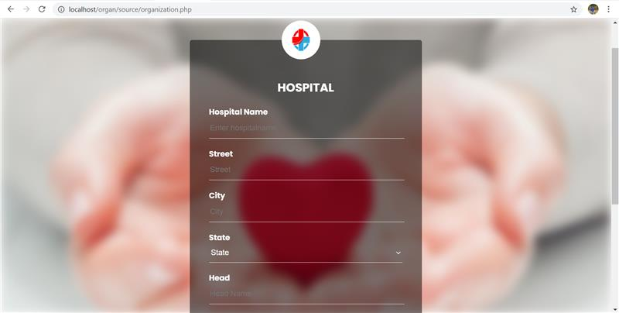
ORGANIZATION FORM
$sql="INSERT INTO organization (organisation_name,street,city,state,organisation_head) VALUES (:name1,:street,:city,:state1,:head)";
$sql1="INSERT INTO organisation_ph (organisation_id,phone_no) VALUES (:user,:phone1)";

Slide 33
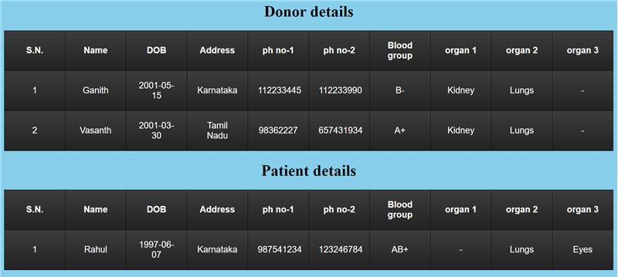
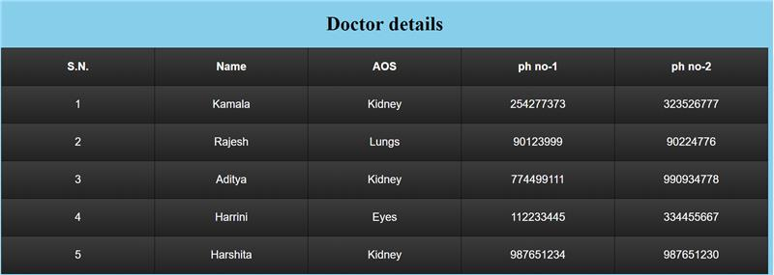
DETAILS VIEWED BY ORGANIZATION
$stmt=$pdo->query("SELECT distinct donor.donor_id,name1,blood_group,organisation_name,organisation.street,organisation.city,organisation.state,user_ph.phone_no FROM user2 INNER JOIN donor_organ INNER JOIN donor INNER join user_ph ON user2.user_id=user_ph.user_id and donor_organ.donor_id = donor.donor_id and user2.user_id=donor.user_id INNER JOIN organisation on donor.organisation_id=organisation.organisation_id INNER JOIN organisation_ph on organisation_ph.organisation_id=organisation.organisation_id;");

Slide 34
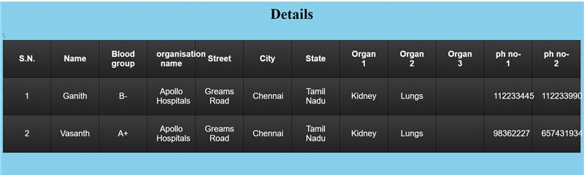
Available organs details
$stmt=$pdo>query("SELECT distinct donor.donor_id,name1,blood_group,organisation_name,organisation.street,organisation.city,organisation.state,user_ph.phone_no FROM user2 INNER JOIN donor_organ INNER JOIN donor INNER join user_ph ON user2.user_id=user_ph.user_id and donor_organ.donor_id = donor.donor_id and user2.user_id=donor.user_id INNER JOIN organisation on donor.organisation_id=organisation.organisation_id INNER JOIN organisation_ph on organisation_ph.organisation_id=organisation.organisation_id;");

